Slide 1
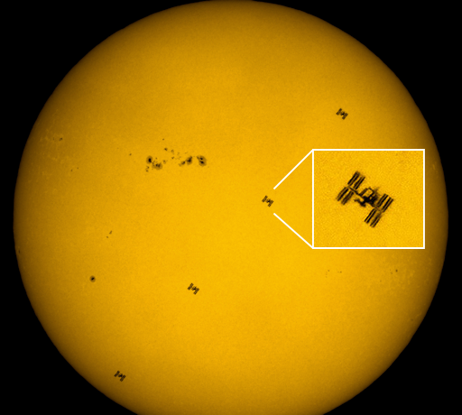
Solar Transit Prediction
Kalyan

Slide 2
Preliminaries
Transits?
A transit occurs when one object appears to pass in front of another object

Slide 3
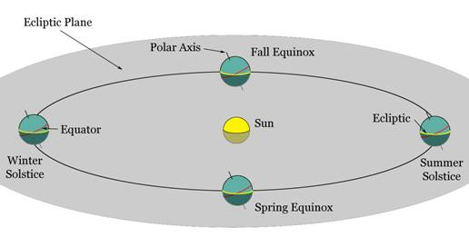
Preliminaries
Ecliptic Plane?
Ecliptic plane is a plane of the Earth’s orbit around sun

Slide 4
Motivation
Tracking the attitude/orientation of satellite with failed attitude sensors

Slide 5
Objective
Determine the time and location on earth’s surface (to place camera) to capture satellite’s silhouette during solar transit.

Slide 6
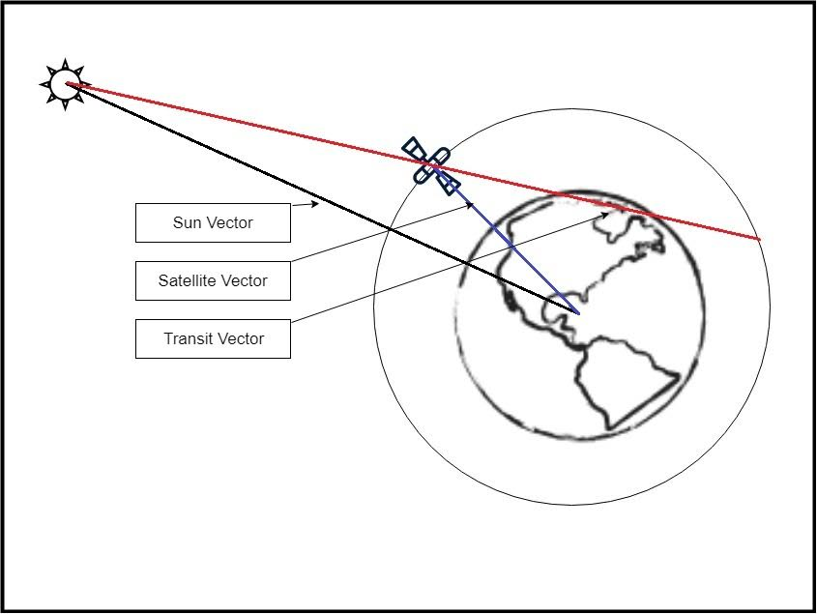
Transit Prediction Model

Slide 7
Reference Frames
Geocentric Reference Frames:
Ecliptic Frame
Equatorial Inertial Frame
Earth Centered Earth Fixed
Latitude Longitude Altitude

Slide 8
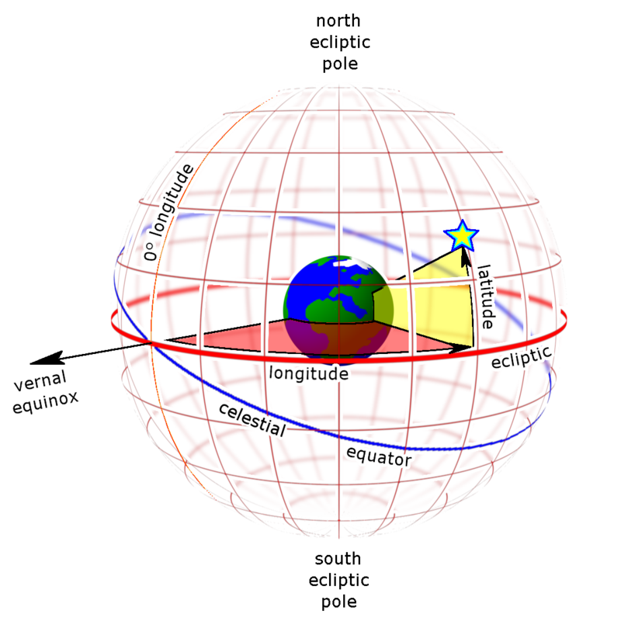
Ecliptic Frame of Reference

Slide 9
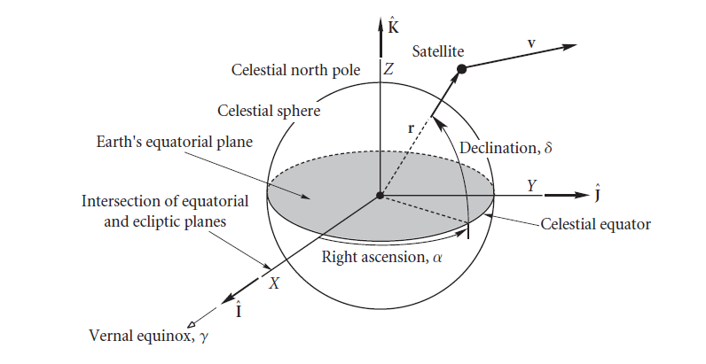
Earth Centered Inertial Frame

Slide 10
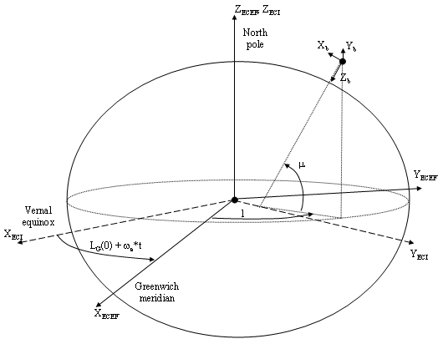
Earth Centered Earth Fixed Frame

Slide 11
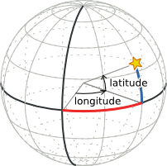
Latitude Longitude Elevation

Slide 12
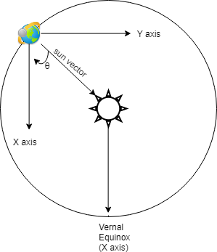
Calculating Sun Vector
X = R*cos(θ)
Y = R*sin(θ)
Z =0
Ecliptic Reference Frame

Slide 13
Calculating Sun Vector
Transformation matrix T_{Ecliptic}^{ECI}
Ecliptic to Earth Centered Inertial Frame
1 | 0 | 0
0 | cos( ε) | -sin( ε)
0 | sin( ε) | cos( ε)
ε is the angle between Equatorial plane(blue) and Ecliptic plane(red)

Slide 14
Calculating Sun Vector
Transformation matrix T_{ECI}^{ECEF}
ECI to ECEF Frame
cos(ωt+φ) | sin(ωt+φ) | 0
-sin(ωt+φ) | cos(ωt+φ) | 0
0 | 0 | 1
ω is the Earth’s angular velocity
φ is the angular constant

Slide 15
Calculating Sun Vector
V_{sun}^{ECEF} = T_{ECI}^{ECEF}.T _{ecliptic}^{ECI} .V_{sun}^{ecliptic}

Slide 16
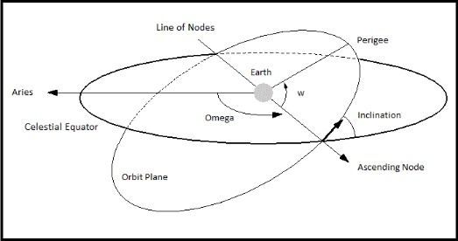
Calculating Satellite Vector
In the next few slides we will visulaize the different parameters needed to define a satellite’s orbit.

Slide 17
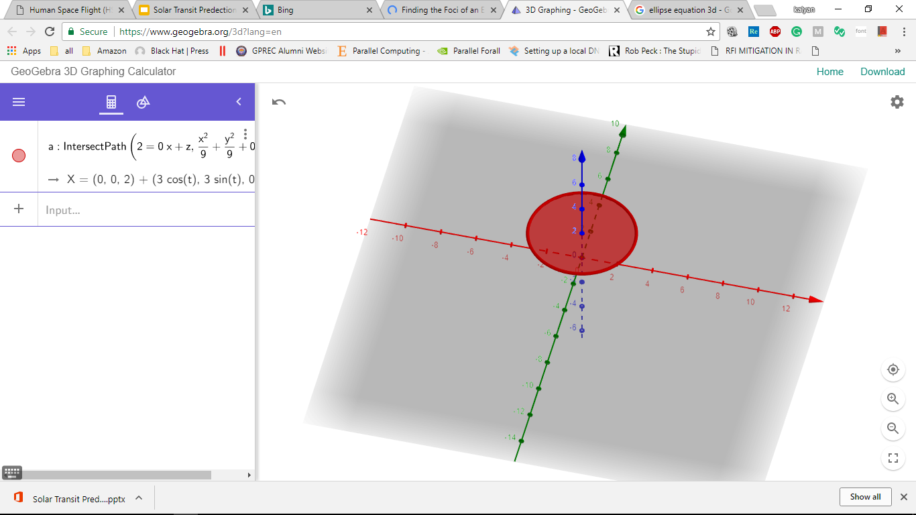
How far the satellite is?

Slide 18
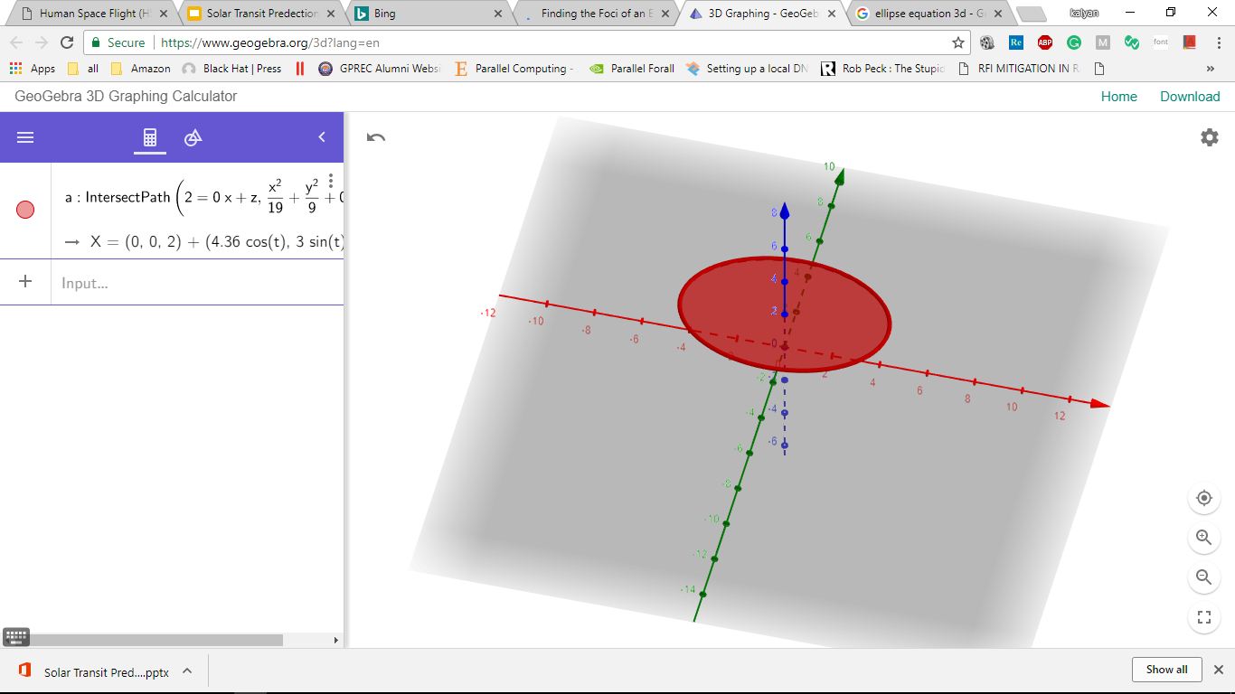
How elliptic the orbit is?

Slide 19
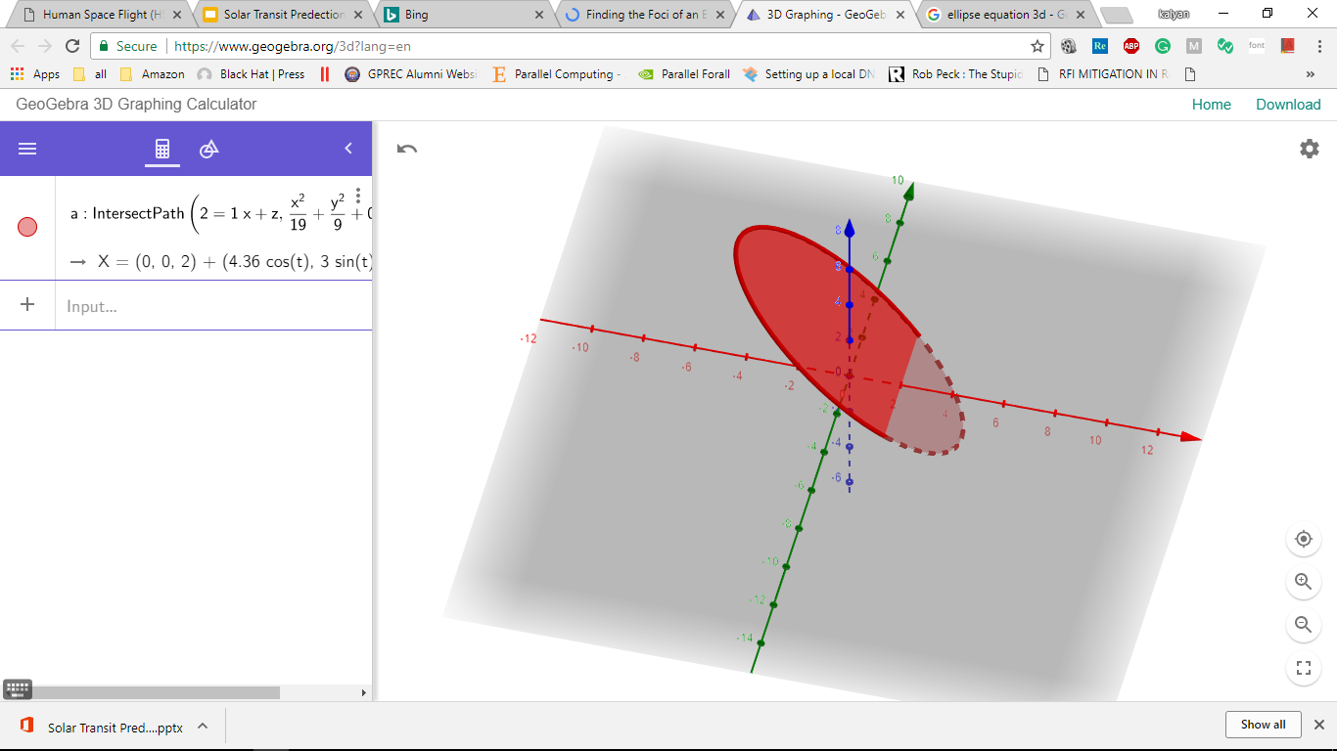
Inclination of orbit

Slide 20
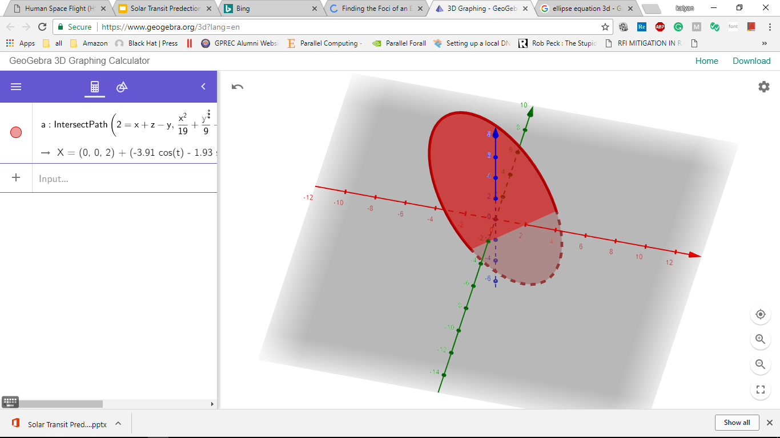
Angl of the inclination axis

Slide 21
Where do we get the Satellite Orbital data?
TWO LINE ELEMENTS
Example:
ISS 1 25544U 98067A 18087.69548005 .00016717 00000-0 10270-3 0 9008 2 25544 51.6413 59.9899 0001781 276.9125 83.1825 15.54162944 25993

Slide 22
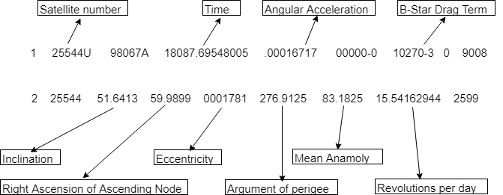
Two Line Elements

Slide 23
Location of interest
The location of interest is the point of intersection between transit vector and the surface of the Earth.

Slide 24
Location of interest
Location of interest will give us lat & lon and time.
That means, if we go to the specified lat lon and capture the image of the sun at specified time, we will be able to see the satellite in the captured image

Slide 25
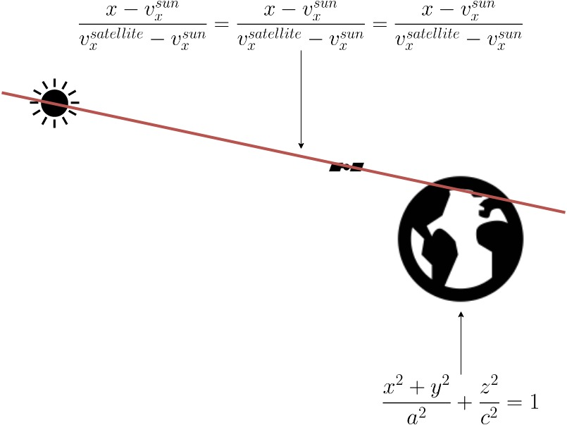
Equations

Slide 26
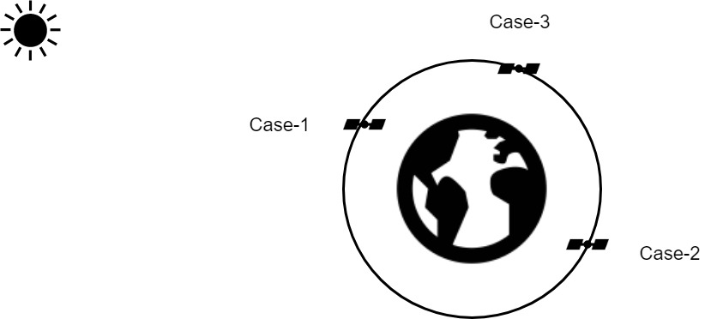
Cases
There are three different cases based on the location of satellite and sun.

Slide 27
Results
List of all the (time and location) points which describes when and where we can capture the transits.

Slide 28
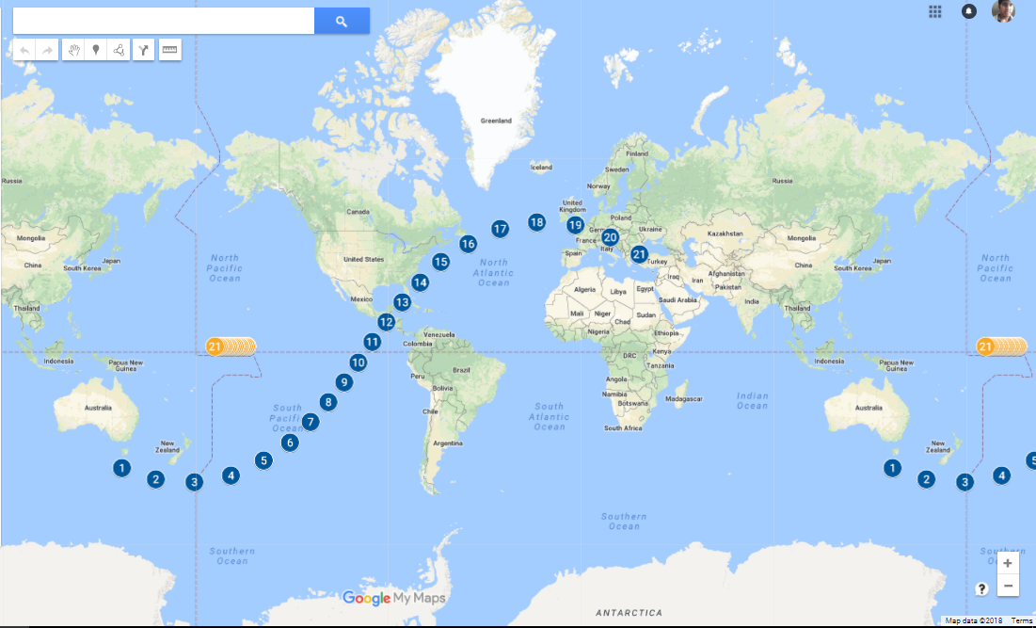
SUN
--- SUN’S PATH OVER EARTH’S SURFACE
--- SATELLITE’S PATH OVER EARTH’S SURFACE
Satellite- ISS (ZARYA)
Sub satellite points

Slide 29
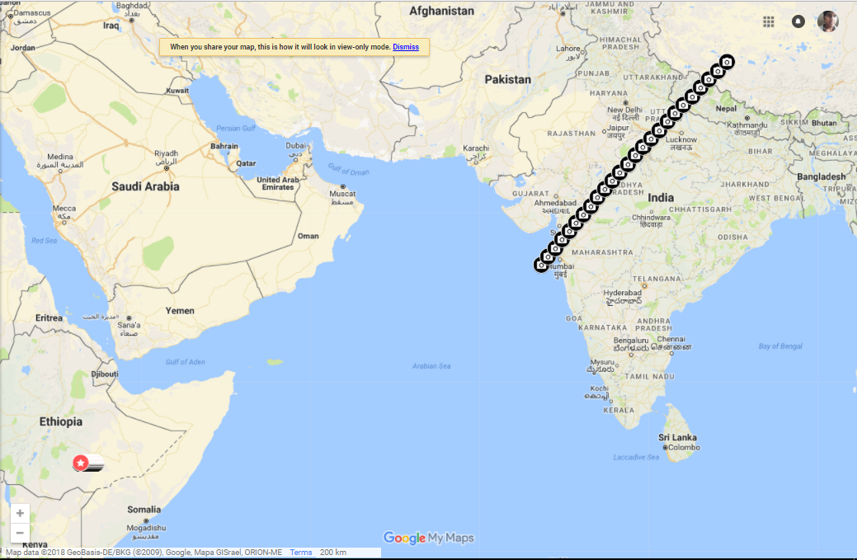
Transit locations
SUN
SITE’S WERE WE CAN CAPTURE THE SOLAR TRANSIT

Slide 30
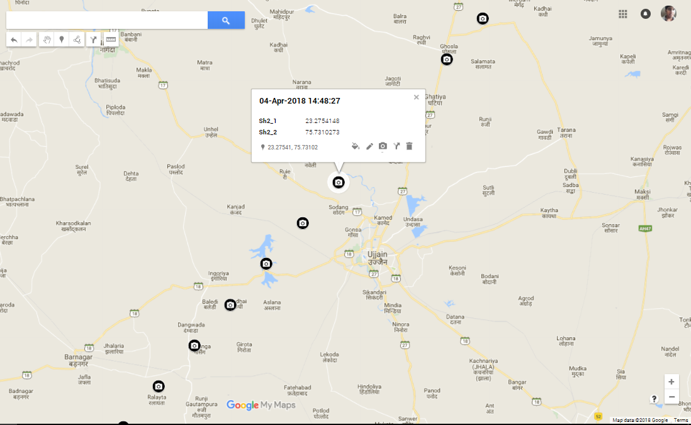
The transit nearest to IIT Indore on April 4th occuring near Ujjain

